Slide 1
Special Topics in a Digital and Big Data World
Laura Brandimarte
September 28, 2017

Slide 2
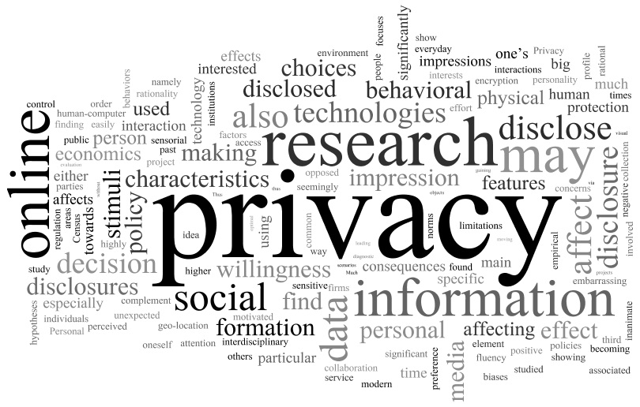
My research in a few words…
Notes:
“This is a word cloud of my research statement. I believe it is a good visual representation of my research interests and agenda.”
[talk about main words]
“One important word that’s missing from this picture is Experiments, the reason being that my research statement focuses more on topics and research areas than methodologies.”

Slide 3
My research in a diagram
Privacy decision making
Design
Policy
Online disclosure
Social media
sharing
Behavioral
economics
Economics
Human-computer interaction
Computer-mediated communication
Experimental methodology

Slide 4
Social Engineering Experiments
- Work in Progress -
with Matthew Hashim and Jesse Bockstedt

Slide 5
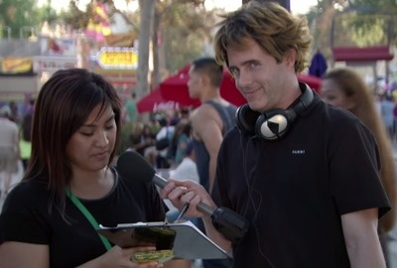
“Sign a Petition to Raise Awareness for Internet Safety”
Produced by ProtectYourSelfie.org
video available at: https://vimeo.com/132377755

Slide 6
Another Important Example…
CIA director Brennan’s PII breached in October 2015
  Fake technician on a “customer callback” tricked a Verizon employee… “the system was down”
  The tricked employee used the Verizon system to provide information about Brennan
    Verizon account number and PIN
    Backup mobile number on the account
    AOL email address and the last four digits on his bank card
  Used the PII to hack Brennan’s email
  Email contained private records (including CIA names and SSNs)

Slide 7

Social Engineering Defined
“The psychological manipulation of people into performing actions or divulging confidential information.”
Also known as … human hacking …
  Pretexting, phishing, baiting, tailgating, and others…
Recently brought to the masses on TV
  http://observer.com/2015/11/how-watching-mr-robot-made-me-paranoid-about-getting-hacked/

Slide 8
Research Motivation
Why do IS researchers care about social engineering?
  Technology controls are easily bypassed
  We can adapt to threats and “patch” technology
  We can “train” humans … or can we?
Fundamental need to understand factors that lead to social engineering exploits
  Threats to information security begin with humans
  Once exploited, technology “patches” may not matter
  Gateway to additional attacks on systems

Slide 9
Gaps in the Related Literature
Phishing experiments (e.g., Jagatic et al. 2007)
  Social context is more successful than random target
  Gender of the receiver of the phishing email matters
Fake-website detection
  Behavioral aspects (e.g., protection motivation theory)
  Detection tools (e.g., Abbasi et al. 2010)
  Recent Equifax breach
Besides phishing, randomized field experiments in social engineering are largely lacking…

Slide 10
Field Experiment Challenges
Serious concerns from the Human Subjects Protection Program (IRB)
  Clear deception of participants
  Process of obtaining consent
  Storage of PII? Risks to participants because of the PII?
Procedures to protect human participants
  Raffles for the prizes are real
  Participants are immediately debriefed
  PII is immediately shredded onsite in view of the subject
  Randomization of treatments and participants approached

Slide 11
Study 1: Tell me about your PII
What factors make individuals likely to provide their personally identifiable information (PII)?
  High vs. low rewards?
  Charitable vs. non-charitable organizations?
  Does the gender of the target and/or the confederate make a difference in the outcome?

Slide 12
Related Literature
Information Security Compliance
  Policies within an organization (e.g., D’Arcy et al. 2009)
  Training Matters: “Teaching Johnny Not to Fall for Phish” (Kumaraguru et al. 2010)
  Training Doesn’t Matter: “Going Spear Phishing…” (Caputo et al. 2014)
Disclosure of private information
  Trade monetary rewards or customization for PII
    Grossklags and Acquisti 2005; 2007
    Ghose 2017
  Decisions influenced by altruistic rewards
    Peltier 2006
    Colin and George 2004
    Schwarz 2000

Slide 13
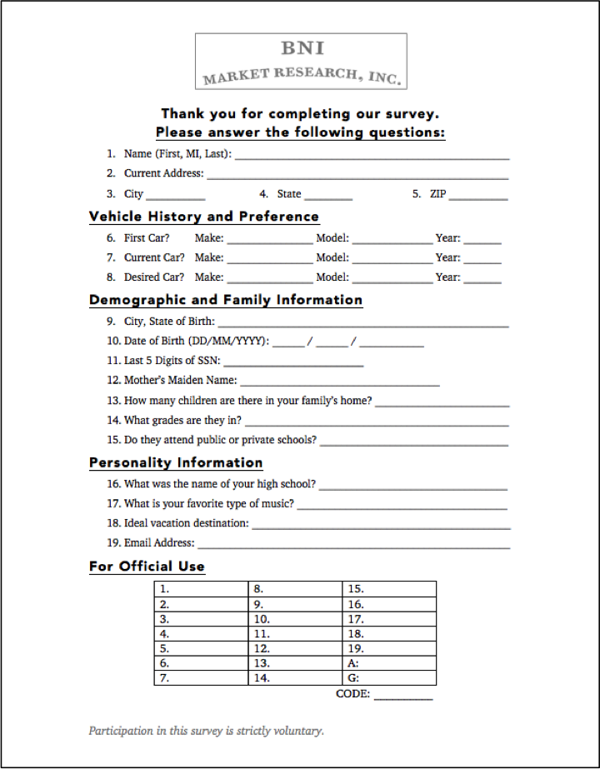
Experiment Design
Two factors
  Reward (high vs. low)
    iPad raffle
    Pizza Dinner raffle
  Context (charitable cause vs. commercial cause)
    Books for Kids
    BNI Market Research, Inc.

Slide 14
Does SSN and/or PII Matter?
Social security numbers (SSN) are widely used to perpetrate fraud and identity theft in the US
SSNs may be predicted using public data (Acquisti and Gross, 2009)
  First 5 digits can be predicted with 44% accuracy on the first attempt
  After 1989, applications for an SSN usually occur at birth (predict first 3 digits (AN) based on location of birth)
  Birth date and location of birth can be used to predict middle 2 digits (GN)
  The last 4 digits (SN) are assigned serially, not randomly, and therefore can be inferred from birth records

Slide 15
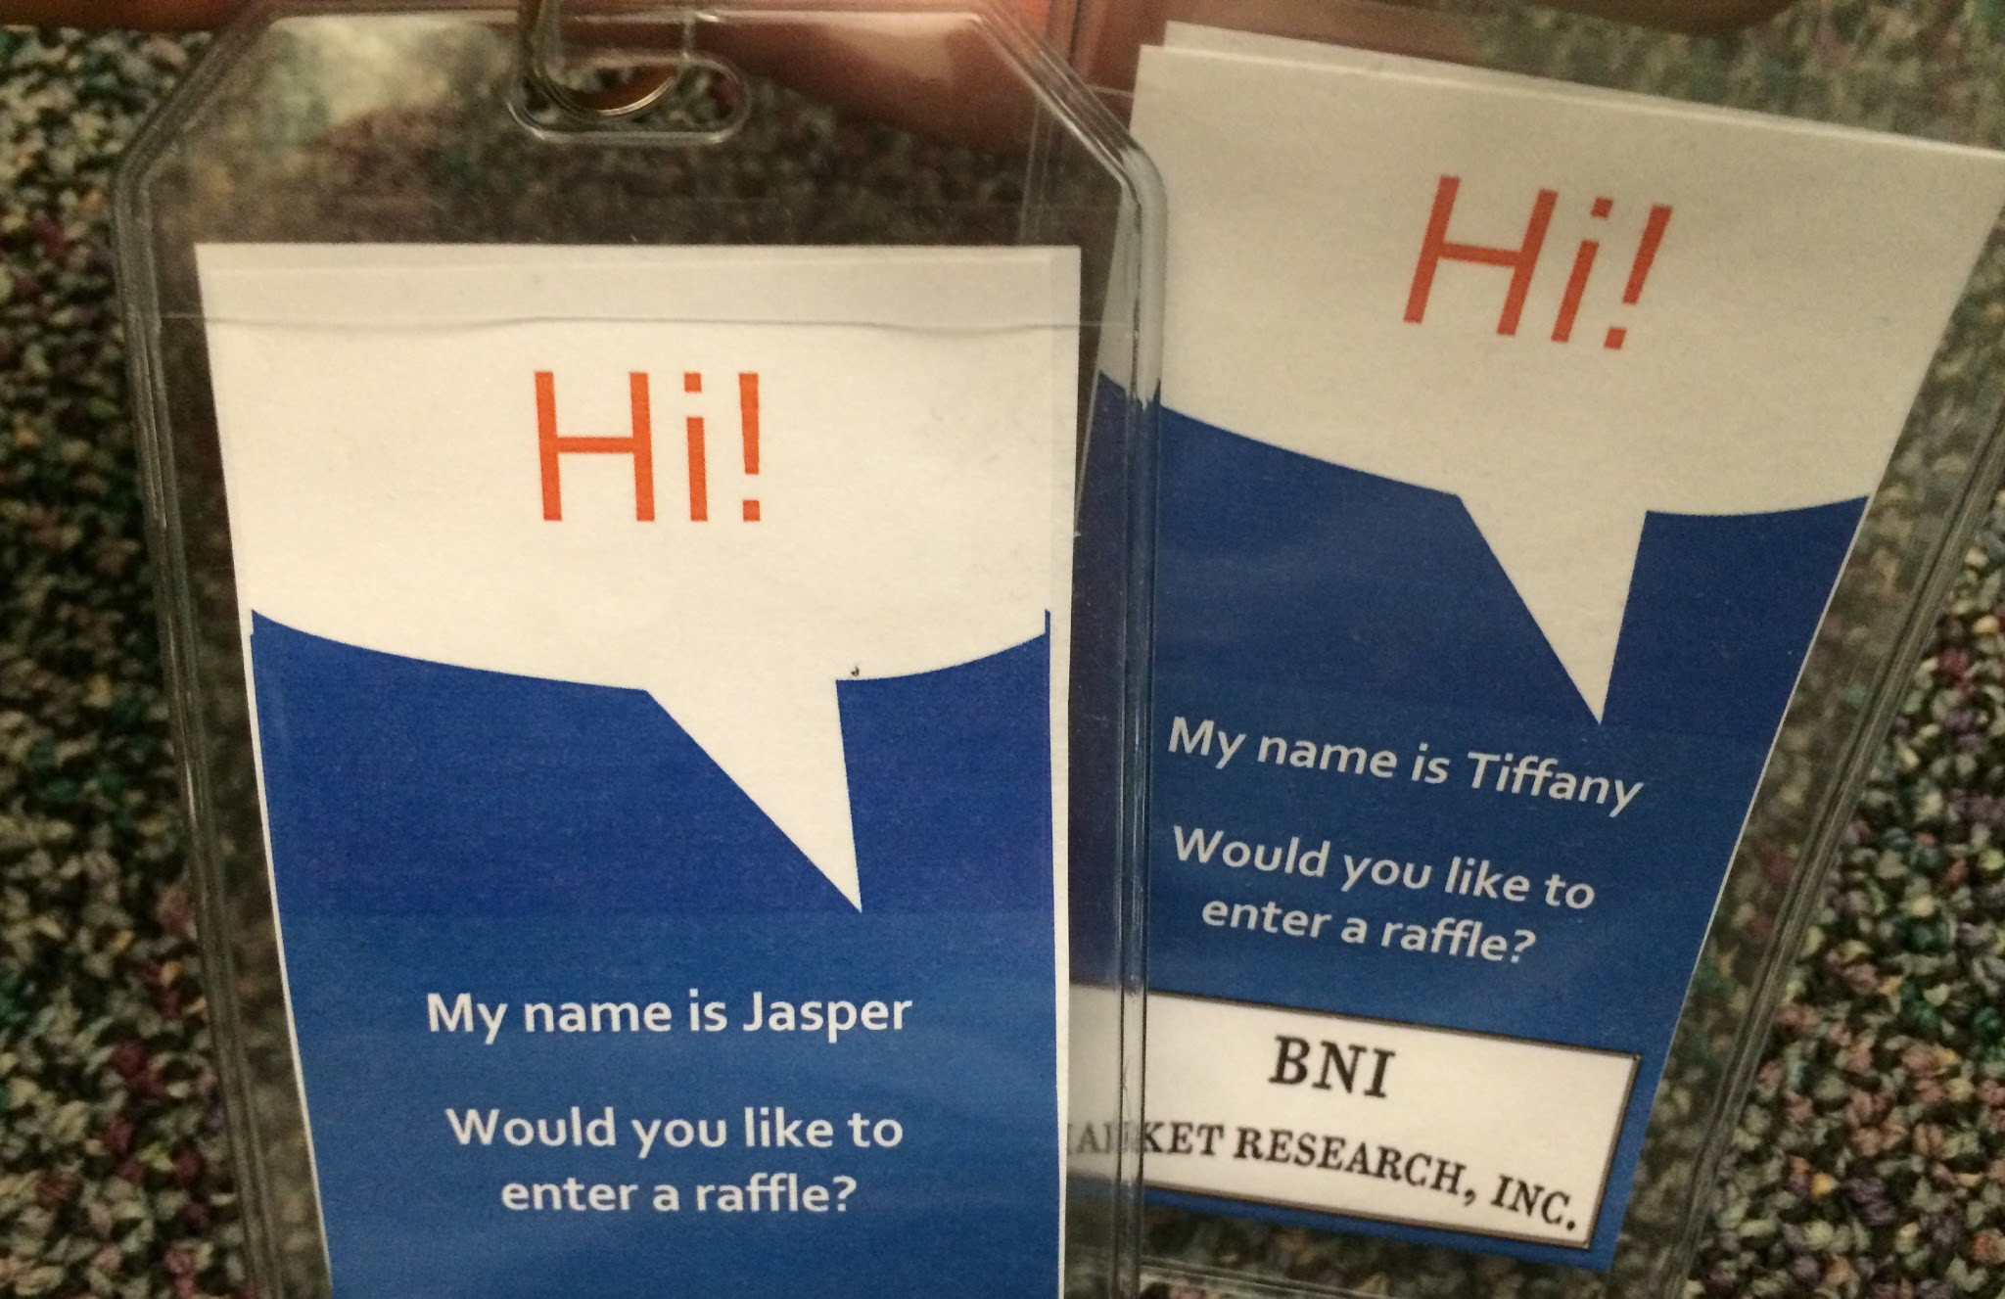
Experiment Procedure
Field was a busy walking area at the Student Union
Researcher roles
  Several confederates
    “Official” lanyards
    Men and women
    Varied ages and ethnicities
  Observers
    “Consent / Debrief”
    “Shredder / Note Taker”

Slide 16
Experiment Procedure
Scripted interactions with subjects to capture the two factors
  “Excuse me, would you like to enter a raffle to win a free iPad? It’s for charity.” (high reward; charitable context)
  “Excuse me, would you like to enter a raffle to win a free pizza? It’s for market research.” (low reward; market research context)

Slide 17
Experiment Procedure
Role details
  Confederate
    Approach every ~3rd subject (to avoid biases)
    Introduce themselves, ask their interest to enter a raffle
    Ask subject to fill out a clipboard with PII
  Consent / Debrief
    Inform subject the survey was bogus
    Explain the reason is an academic research experiment
    Ask for consent to use their data
    Inform subject the raffle is real – they can enter regardless of consent to use data

Slide 18
Experiment Procedure
Role details (cont.)
  Shredder / Note Taker
    Observe gender and approximate age of subject
    Take notes of other observed information
    Tick fields where PII entered (i.e., yes/no)
    Shred the PII in view of the subject using a portable shredder
    Destroy the shredded PII forms using a secure document destruction service
Treatment assignment
  2 hour collection windows
  Alternated treatments every 20-25 minutes
  3-4 minutes to gather PII per subject

Slide 19
Initial Quantitative Results
Conducted 10 data collection sessions
  540 rejections
  118 observations where PII recorded (~18%)
  Logistic regression analyses show
    Reward by itself is significant (Pizza!)
    Context by itself is not significant
    Significant interaction: Pizza reward in the Commercial context
    Gender match between confederate and subject is significant
% of PII Disclosed by Factor

Slide 20
Initial Quantitative Results
DV is based upon disclosure of PII
  1 = disclosed all 5 PII questions of interest
  0 = did not disclose all 5 PII questions
Results from logistic regression
Variable | Coefficient | Odds Ratio | S.E. | P > |z|
High Reward (iPad) | -1.41 | 0.37 | 0.69 | 0.041
Charity Context (BFK) | -1.00 | 0.24 | 0.62 | 0.108
High Reward w/ Charity Context | 2.14 | 8.51 | 0.96 | 0.026
Subject Gender | 0.29 | 1.34 | 0.48 | 0.549
Subject Age | 0.02 | 1.02 | 0.03 | 0.508
Confederate Gender | 0.54 | 1.72 | 0.48 | 0.259
Gender Match | 1.14 | 3.14 | 0.49 | 0.019

Slide 21
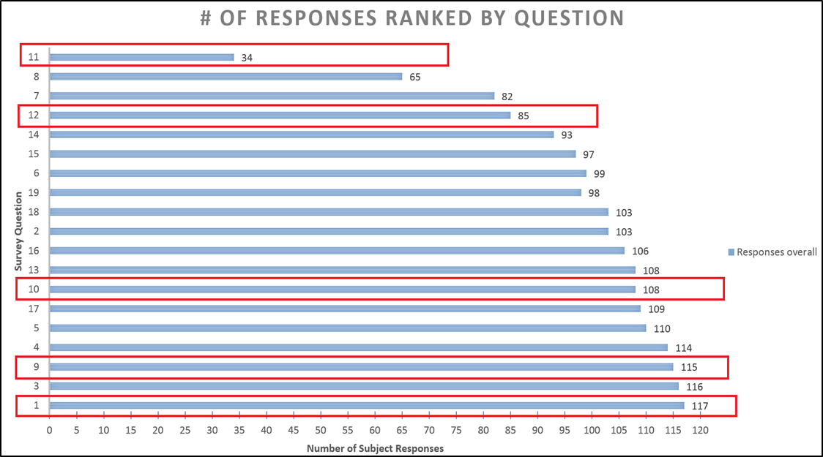
PII Disclosure?
Name (Q1), City and State of Birth (Q9), Date of Birth (Q10), Last 5 of the Social Security Number (SSN) (Q11), Mother’s Maiden Name (Q12)

Slide 22
Qualitative Results
Our observations revealed several types of people
  Some were tech savvy and suspicious
  Few became very angry
    Either because they were deceived
    Or, because the questions were intrusive
  Most did not seem to care or realize the potential impact of what they were being asked
Subjects Categorized by Commonly Observed Characteristics

Slide 23
Unlike how Sammi feels about social engineering…
[Brendan] My heart sank as I observed them recoil with the realization that they had made an error by exchanging their personally identifiable information for a chance at some material good.

Slide 24
Memorable Quotes
“I realized I had messed up and made a mistake, but it taught me something and it was valuable because it was a situation where there wasn’t any risk attached.”
“I don’t know if “death glare” is a clinical term, but he was very angry in a very quiet and passive-aggressive way.”
“I don’t care what kind of research you’re doing, I’m not giving you this stuff.”

Slide 26
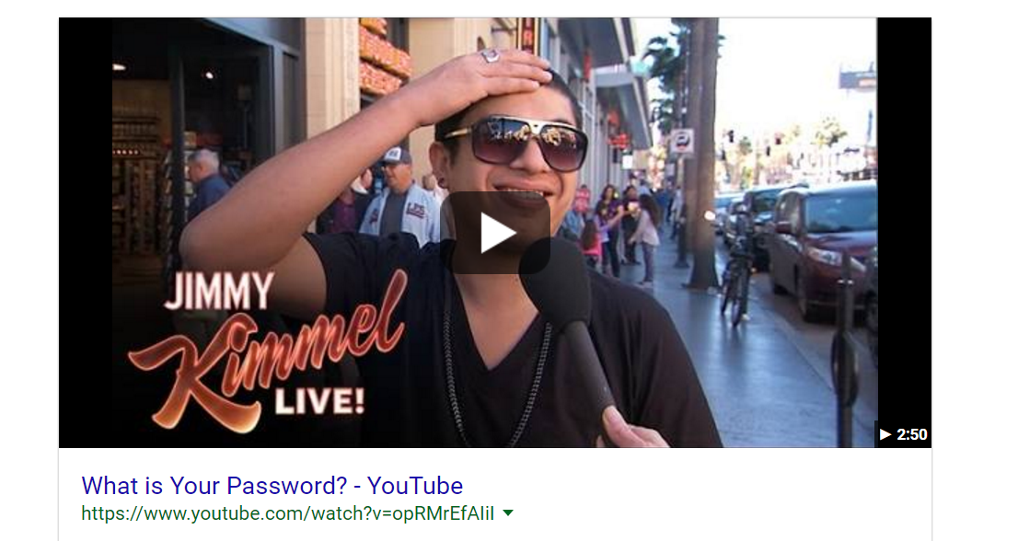
Study 2: What is Your Password?
Video available at: https://www.youtube.com/watch?v=opRMrEfAIiI

Slide 27
Study 2: What is your password?
What factors make individuals likely to provide their passwords?
  Digital vs. analog?
  Secure vs. non-secure data transfer?

Slide 28
Related Literature
Indicators of security / privacy seals affect behavior
  Belanger and Smith, 2002
Paper vs. electronic media
  Balebako et al. 2013
Facial Recognition
  Acquisti et al. 2014

Slide 29
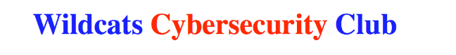

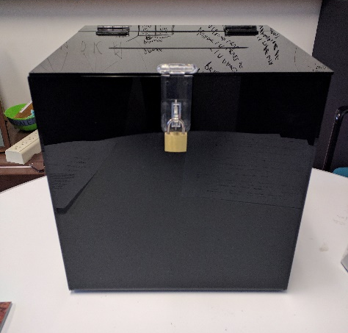
Experiment Design & Procedure
Two factors
  Security Level
    Secure
    Non-Secure
  Media Type
    Paper form
    Electronic form
Upon completion of the form, we also ask:
“Do you mind if we take your picture so we can create a photo collage of all of the people we have helped?”

Slide 30
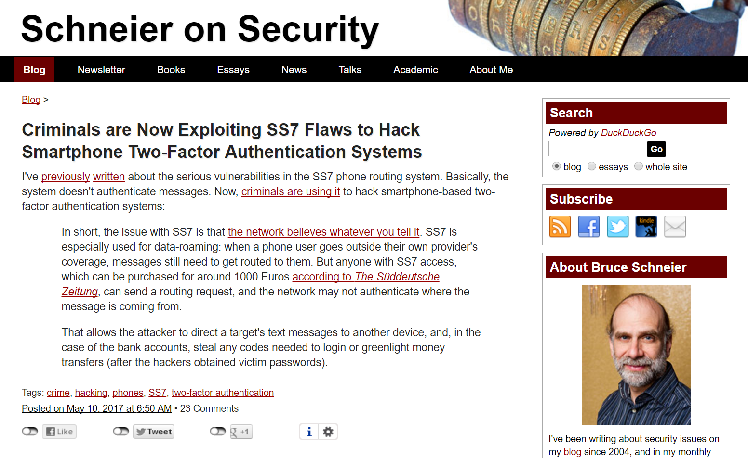
Why ask for their cell number?

Slide 31
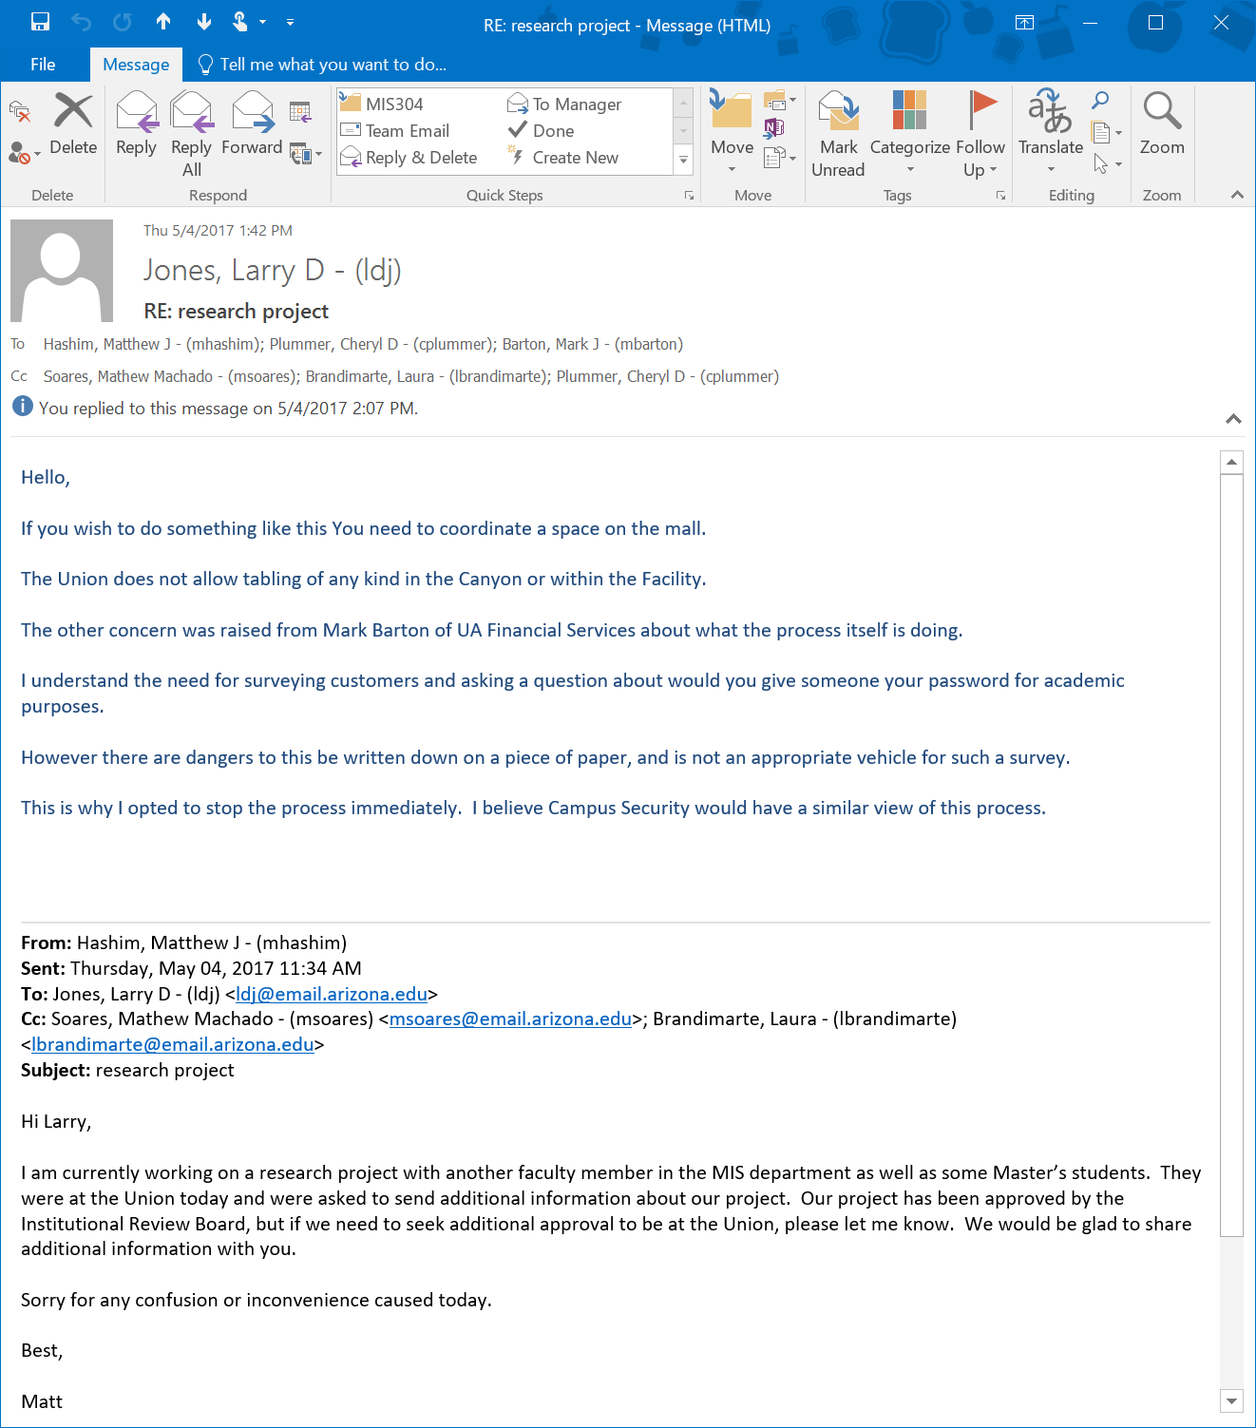
Some Additional Challenges…

Slide 32
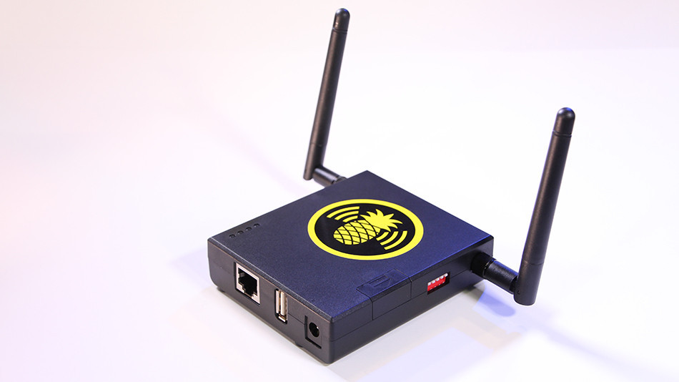
Next Steps

Slide 33
Discussion and Next Steps
Approximately 18% of subjects approached provided some level of PII
  Reward by itself is significant (Pizza!)
  Context by itself is not significant
    Significant interaction: Pizza reward in the Commercial context
  Gender match between confederate and subject is significant
Continued exploration of the data to develop insights as the results presented are preliminary
Potentially explore monetary rewards instead of pizza/iPad rewards
  Correlation between college-age students and the gratification of being rewarded a pizza (Ramani 2014).

Slide 34
Thank you!
Questions?
lbrandimarte@email.arizona.edu

Slide 35
Famous social engineers
  Kevin Mitnick (Art of Deception)
  Chris Hadnagy (DEF CON Soc. Eng. Capture the Flag)

Slide 36
Confederate Stories from Interviews
A lot of people wearing headphones, a lot of rejection, and a lot of being ignored.
There were some subjects who came up to [Calvin], shaking their heads in disappointment that they had given up whatever information they had provided and some said, “I knew something was going on.”
What exactly compelled these individuals to continue to provide PII even if they felt that something fishy was happening?
[Ashley] People were more interested in getting something for free rather than engaging in the context of either the charity or the market research.

